Slide 1
CS670 – ARTIFICIAL INTELLIGENCE
Stylized Motion
Capture Classification
Pablo Bendiksen
Adnan Ali
Shreyas Shirsekar
Sohail Sayeed

Slide 2
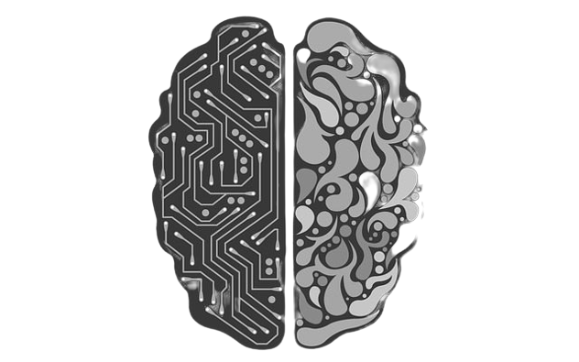
About Neural Networks
Neural networks reflect the behavior of the human brain, allowing computer programs to recognize patterns and solve common problems in the fields of AI, machine learning, and deep learning.
Neural networks and deep learning currently provide the best solutions to many problems in image recognition, speech recognition, and natural language processing.
In this project, our Neural Network has made use of Tensorflow to help with model training and prediction. We have implemented a Convolutional Neural Network into our project

Slide 3
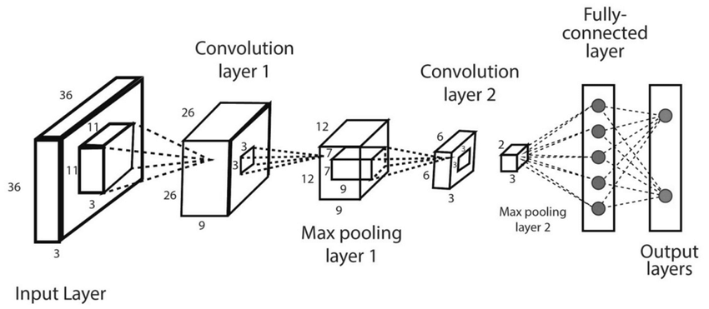
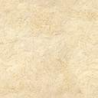
Convolution Neural Networks (CNN)
Convolutional neural networks are distinguished from other neural networks by their superior performance with image, speech, or audio signal inputs. They have three main types of layers, which are:
Convolutional Layer,
Pooling Layer,
Fully Connected Layer
The convolutional layer is the first layer of a convolutional network. While convolutional layers can be followed by additional convolutional layers or pooling layers, the fully-connected layer is the final layer.
With each layer, the CNN increases in its complexity, identifying greater portions of the image. Earlier layers focus on simple features, such as colors and edges. As the image data progresses through the layers of the CNN, it starts to recognize larger elements or shapes of the object until it finally identifies the intended object.

Slide 4
Laban Movement Analysis
Laban Movement Analysis is a technique created by Rudolf Laban to formally describe human movement. Also known as Laban/Bartenieff Movement Analysis, it is used in a broad range of fields such as dance, physical therapy, drama, psychology, and anthropology.
Space
describes how a person connects to their environment; locale, directions, and paths of a movement, and it is partly related to steering.
Shape
determines the way these attitudes are expressed through the body, and it is manifested in postures.
Effort
is the dynamic component, which is used to describe the characteristics of movement based on humans’ inner attitudes.
Body
defines the structural aspects of the human body during motion, i.e., what the body is doing and the relationship of the body parts during motion.

Slide 5
Efforts
One of the categories of LMA, The Effort quality, describes the dynamical characteristics of movement driven by a person’s inner attitude, capturing subtle individual characteristics, thus epitomizing movement style.
Each quality changes within the range of two extremes of indulging (-) and condensing (+):
(-) Indirect Space Direct (+)
[describes attention to the environment]
(-) Light Weight Strong (+)
[specifies the sense of impact of one’s movement]
(-) Sustained Time Sudden (+)
[describes the attitude toward time with a sense or lack of urgency]
(-) Free Flow Bound (+)
[encapsulates continuity, bodily tension, and control]
Space
Weight
Efforts
Time
Flow

Slide 6
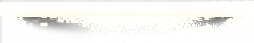
Predicting Basic Efforts
Human beings exhibit efforts in combinations, usually in groups of two or three. Combinations of three out of four efforts are known as Drives, where the remaining effort is said to be neutral.
In order to increase perceivability, we focused on generating Drives where the three expressed efforts captured extreme values (e,g. (+1, -1, 0, +1), (-1, -1,-1, 0), etc).
Motions were stylized using the PERFORM framework, a programmatic tool—designed in collaboration with certified LMA experts—that maps dozens of low-level motion parameters to effort values.

Slide 7
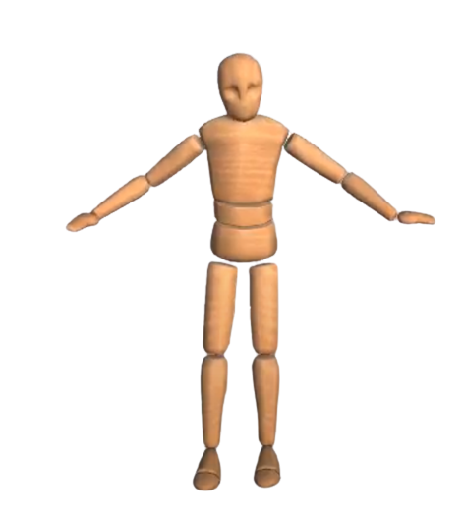
Feature Extraction
Absolute Position –
Hips_Xposition', 'Hips_Yposition', 'Hips_Zposition',
Rotations –
'Hips_Zrotation', 'Hips_Xrotation', 'Hips_Yrotation', 'LeftUpLeg_Zrotation', 'LeftUpLeg_Xrotation', 'LeftUpLeg_Yrotation', 'LeftLeg_Zrotation', 'LeftLeg_Xrotation', 'LeftLeg_Yrotation', 'LeftFoot_Zrotation', 'LeftFoot_Xrotation', 'LeftFoot_Yrotation', 'LeftToeBase_Zrotation', 'LeftToeBase_Xrotation', LeftToeBase_Yrotation', 'RightUpLeg_Zrotation', 'RightUpLeg_Xrotation', 'RightUpLeg_Yrotation', 'RightLeg_Zrotation', 'RightLeg_Xrotation', 'RightLeg_Yrotation', 'RightFoot_Zrotation', RightFoot_Xrotation', 'RightFoot_Yrotation', 'RightToeBase_Zrotation', 'RightToeBase_Xrotation', 'RightToeBase_Yrotation', 'Spine_Zrotation', 'Spine_Xrotation', 'Spine_Yrotation', 'Spine1_Zrotation', 'Spine1_Xrotation', 'Spine1_Yrotation', 'Spine2_Zrotation', 'Spine2_Xrotation', 'Spine2_Yrotation', 'LeftShoulder_Zrotation', 'LeftShoulder_Xrotation', 'LeftShoulder_Yrotation', 'LeftArm_Zrotation', 'LeftArm_Xrotation', 'LeftArm_Yrotation', 'LeftForeArm_Zrotation', 'LeftForeArm_Xrotation', 'LeftForeArm_Yrotation', 'LeftHand_Zrotation', 'LeftHand_Xrotation', 'LeftHand_Yrotation', 'LeftHandIndex1_Zrotation', 'LeftHandIndex1_Xrotation', 'LeftHandIndex1_Yrotation', 'LeftHandIndex2_Zrotation', 'LeftHandIndex2_Xrotation', 'LeftHandIndex2_Yrotation', 'LeftHandIndex3_Zrotation', 'LeftHandIndex3_Xrotation', 'LeftHandIndex3_Yrotation', 'Neck_Zrotation', 'Neck_Xrotation', 'Neck_Yrotation', 'Head_Zrotation', 'Head_Xrotation', 'Head_Yrotation', 'RightShoulder_Zrotation', 'RightShoulder_Xrotation', 'RightShoulder_Yrotation', 'RightArm_Zrotation', 'RightArm_Xrotation', 'RightArm_Yrotation', 'RightForeArm_Zrotation', 'RightForeArm_Xrotation', 'RightForeArm_Yrotation', 'RightHand_Zrotation', 'RightHand_Xrotation', 'RightHand_Yrotation', 'RightHandIndex1_Zrotation', 'RightHandIndex1_Xrotation', 'RightHandIndex1_Yrotation', 'RightHandIndex2_Zrotation', 'RightHandIndex2_Xrotation', 'RightHandIndex2_Yrotation', 'RightHandIndex3_Zrotation', 'RightHandIndex3_Xrotation', 'RightHandIndex3_Yrotation'

Slide 8
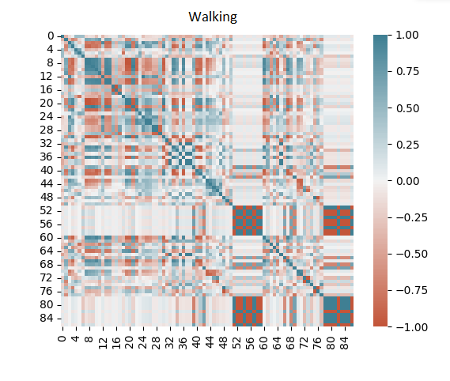
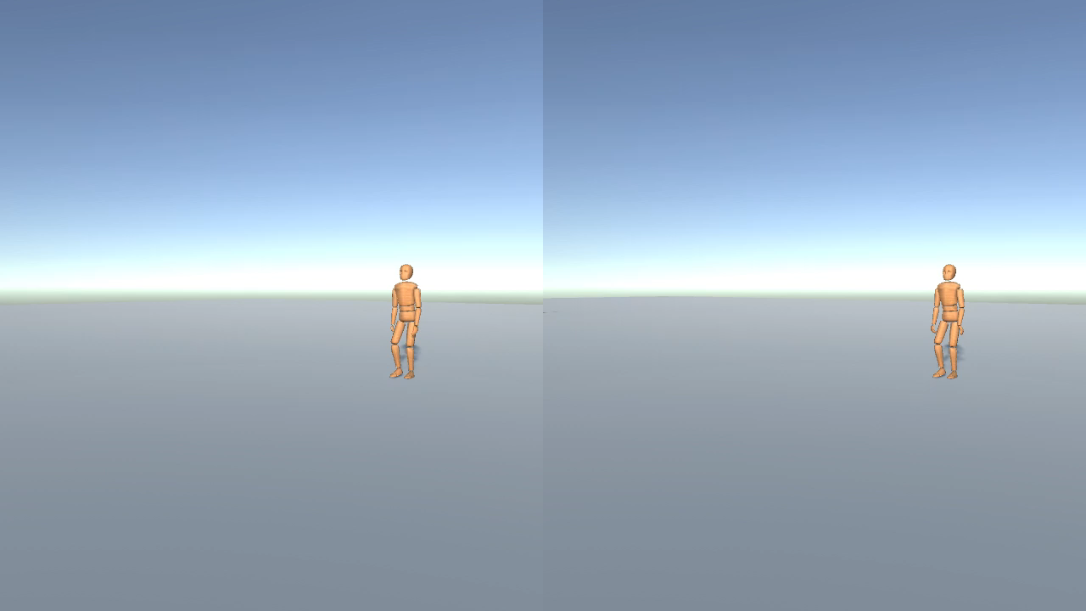
Frames used for Walking Action

Slide 9
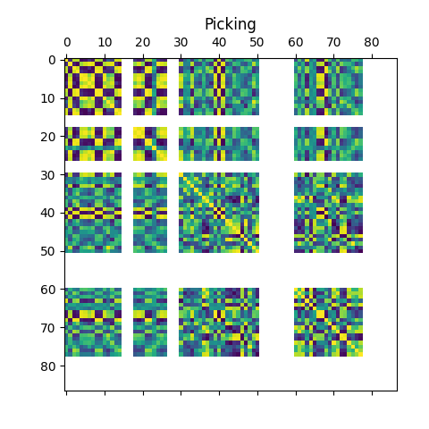
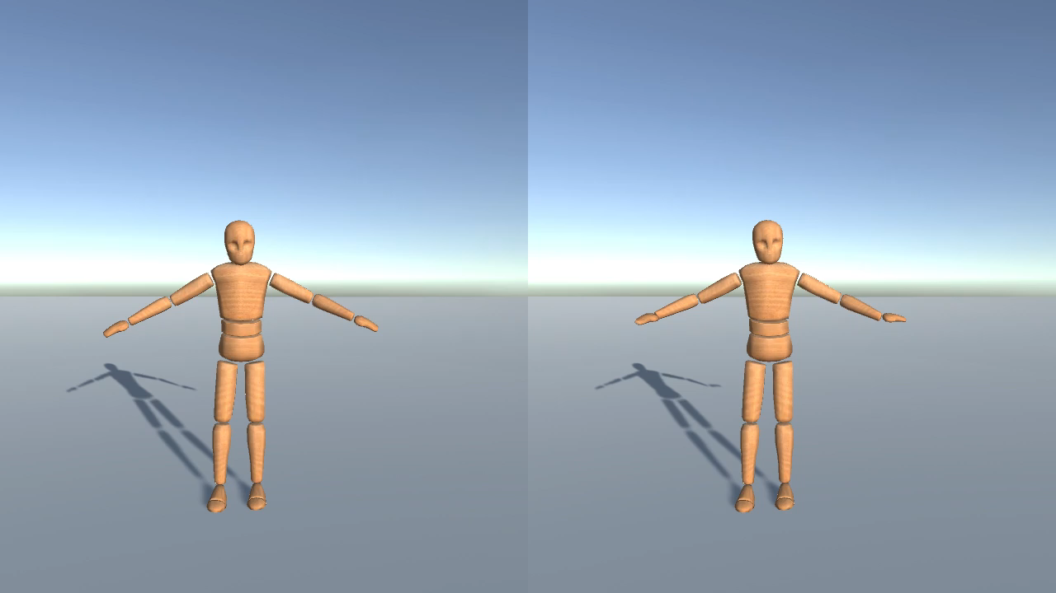
Frames used for Picking Action

Slide 10
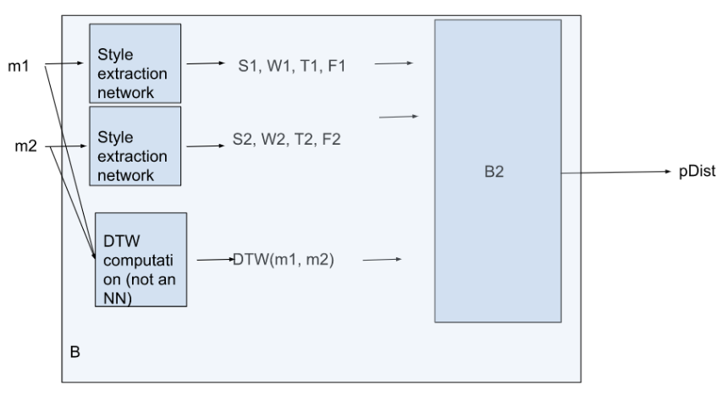
Style Extraction Network
Our plan for our use of Neural Networks is to make use of Tensorflow to help with model training and prediction. We want to implement various models to the end of maximizing Drive predictions. We want to create the Loss function: “MSE.” We plan on using the Adaptive Movement Estimation (Adam) optimizer, given its popularity, to reduce errors in our predictions and specifically use a method in Adam to compute the adaptive learning rate for each parameter.
The method uses both the decaying average of past gradient and decaying average of past squared gradient “RMSProp” algorithm. Lastly, we plan on implementing velocities to the movement of our body part features.

Slide 11
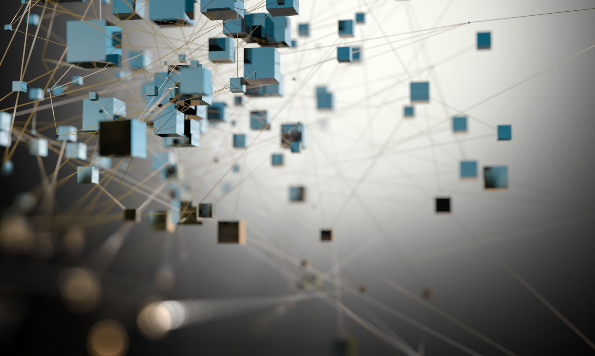
BUILDING OUR NEURAL NETWORK

Slide 12
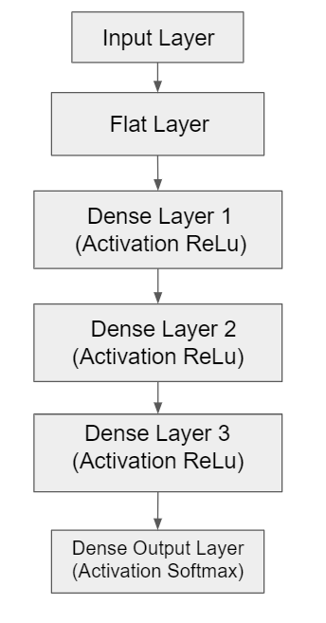
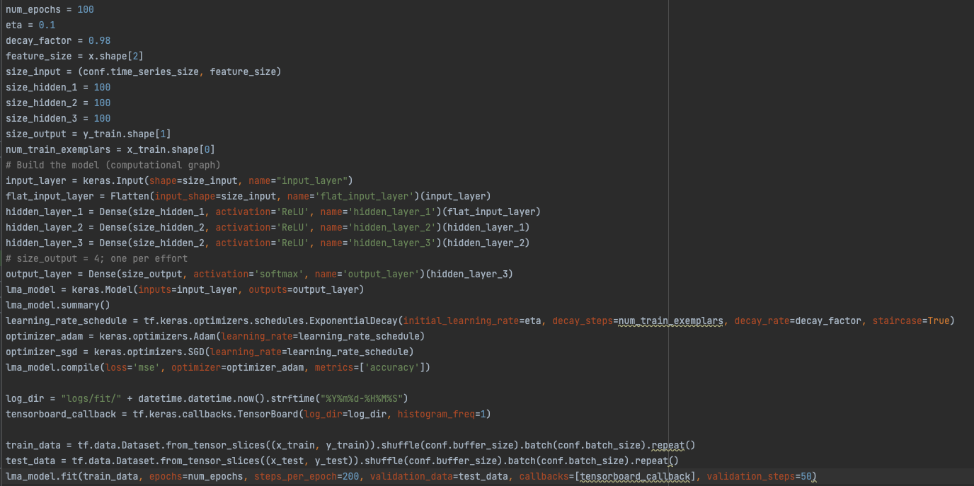
Dense Network (1st Attempt)

Slide 13
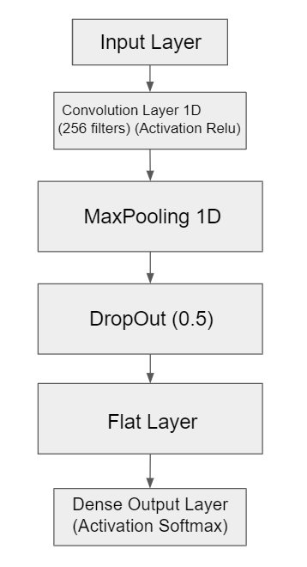
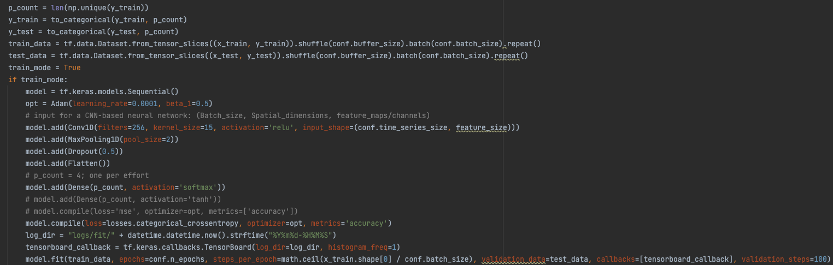
CNN Network (2nd Attempt)

Slide 14
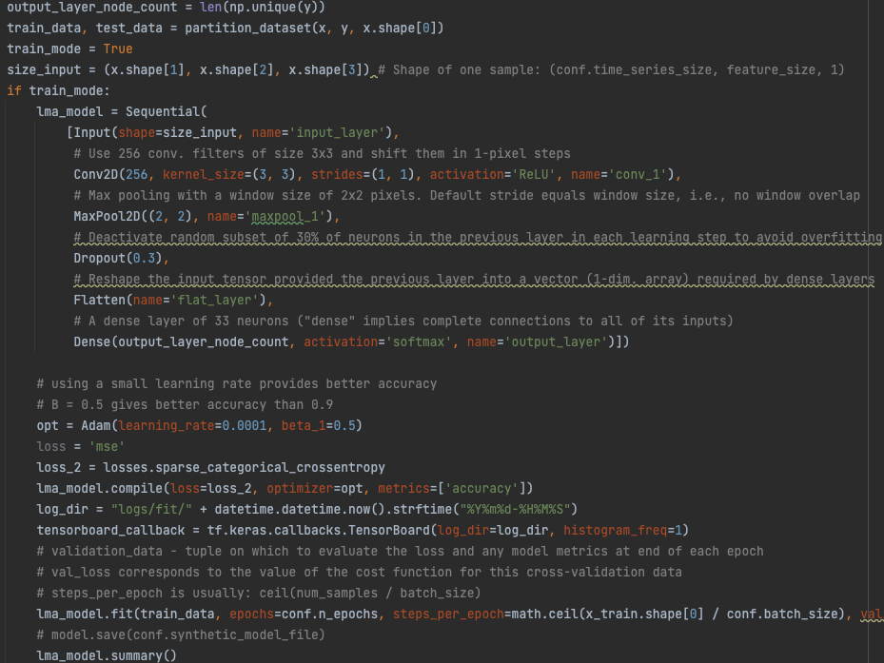
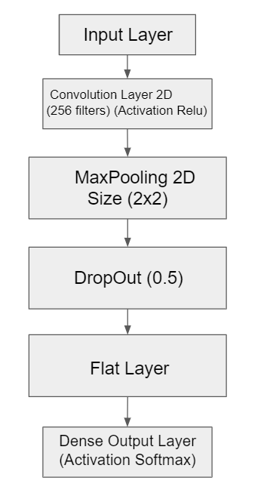
CNN Network (Final)

Slide 15
Summary
Our ‘model tuning’ took the form of an iterative approach wherein we tested more than one model. We experimented with different filter sizes for Convolutional Neural Networks (CNNs) as well as two forms of regularization - dropout and Max Pooling. What made a few interesting observations:
Having started with a dense network, we found that perfect accuracy could not be achieved. Even after 50 epochs, train accuracy ended at _, and test accuracy ended at _.
A 1D CNN was unable to classify all 33 classes perfectly.
By contrast, our 2D CNN achieved perfect accuracy across the three filter sizes when considering all 183 input features, but only for 2 of the filter sizes when inputting the original 87 features. The epoch numbers associated with the start of consistent perfect classification were 30, 15, and 22 for filter sizes of 256, 183, and 87, respectively.
CNN | 256 Filters | 183 Filters | 87 Filters
2D (87 features) | x | 35 | 50
2D (183 features) | 30 | 15 | 22
1D (87 features) | x | x | x
1D (183 features) | x | x | x
Table 1: Epochs to perfect classification
Based on these results we settle for our 2D Convolutional Neural Network, trained on input vectors of 183 features, as our Style Extraction Network to be relied upon for the next stages of the research project.

Slide 16
Citations
Durupinar, F. (2021). Perception of Human Motion Similarity Based on Laban Movement Analysis. ACM Symposium on Applied Perception 2021, 1–7. https://doi.org/10.1145/3474451.3476241
Durupinar, F., Kapadia, M., Deutsch, S., Neff, M., & Badler, N. I. (2017). PERFORM: Perceptual Approach for Adding OCEAN Personality to Human Motion Using Laban Movement Analysis. ACM Transactions on Graphics, 36(1), 1–16. https://doi.org/10.1145/2983620
Wikipedia The Free Encyclopedia. (2022). An example of computer animation using motion capture. Computer animation. Retrieved December 2, 2022, from https://upload.wikimedia.org/wikipedia/commons/6/6d/Activemarker2.PNG.

Slide 17
THANK YOU

